Slide 1


MTC.2 N9151
Using the LooUQ MTC2-N9151 in your application

Slide 2
MTC.2 N9151
The LooUQ MTC2-N9151 (part nm) embedded modem is a compact, drop-in communication device for any number of modern IoT applications.
At the heart of the MTC2-N9151 is a Nordic Semiconductor nRF9151 SIP, the MTC2-N9151 facilitates adding the nRF9151 to your design by building a support ecosystem around the SIP and exposing its features via an industry standard card-edge connector.
The MTC2-N9151 provides both compute with its Cortex M33 application core and communications with its dedicated modem core. Having both MCU and modem in one component lowers BOM cost and provides for rich interactions between application and communications channel.
Notes:
LooUQ designed the MTC2-N9151 to transparently allow for product designer drop-in a Nordic nRF9151 with as little effort as possible. The host system only needs to supply power and a connector. The MTC2-N9151 operates the nRF9151 SIP in a native manner, respecting all operational parameters and providing access to all the 32 GPIO pins.
RF Functionality
Both LTE/NTN and GNSS
GNSS has an internal LNA for clean satellite signal acquisition, and a power injection circuit for external “active” antenna LNAs (two GNSS antenna connections).
Supports LTE (NB-IOT/LTE-M), NTN, and DECT-NR+
Application Functionality
Dedicated application 64 MHz Arm Cortex-M33 core
1 MB flash
256KB RAM
Arm TrustZone + Arm CryptoCell
4 smart serial interfaces (UART, SPI, I2C, I2S)
32 GPIO pins, 8
GNSS has an internal LNA for clean satellite signal acquisition, and a power injection circuit for external “active” antenna LNAs (two GNSS antenna connections).

Slide 3
MTC.2
The MTC2-N9151 leverages the LooUQ MTC.2 interface specification. The MTC.2 interface is built on top of the widely used M.2 connector.
M.2 connectors come in several variants, based on the “keying” of the PCB edge pattern. Most have only a single key slot, some have two.
The LooUQ MTC.2 interface utilizes the “M” key type connector.
Other interfaces utilize the M.2 connector, but they are not compatible with the LooUQ MTC.2 interface.
Notes:
MTC.2 is a proprietary interface using the physical M.2 connector (originally called the NGFF connector)
LooUQ uses TE Connectivity brand connector which is readily available and reasonably priced
The TE Connectivity part number is 1-2199230-6 (M key)
Other logical interfaces based on the M.2 connector: SparkFun MicroMod, PCIe, blues Notecard, etc. These are incompatible with the LooUQ MTC.2 interface.
LooUQ has adjusted typical M.2 slot physical dimensions to help ensure systems are not damaged by the insertion of an MTC.2 device, and MTC.2 devices are not damaged if inserted in an incompatible M.2 connection.
MTC.2 interface specifications are published under a liberal open-source license (MIT license).
The MTC2 Interface Guide is available at https://drive.google.com/file/d/1XxZAA_1KvOwKZDBlQWn0SYPFL24nAV9U/view?usp=drive_link
The interface provides for the MTC.2 device to be active (master) or passive (peripheral device). This allows for modern multi-MCU systems supporting AI and other advanced edge processing patterns.

Slide 4
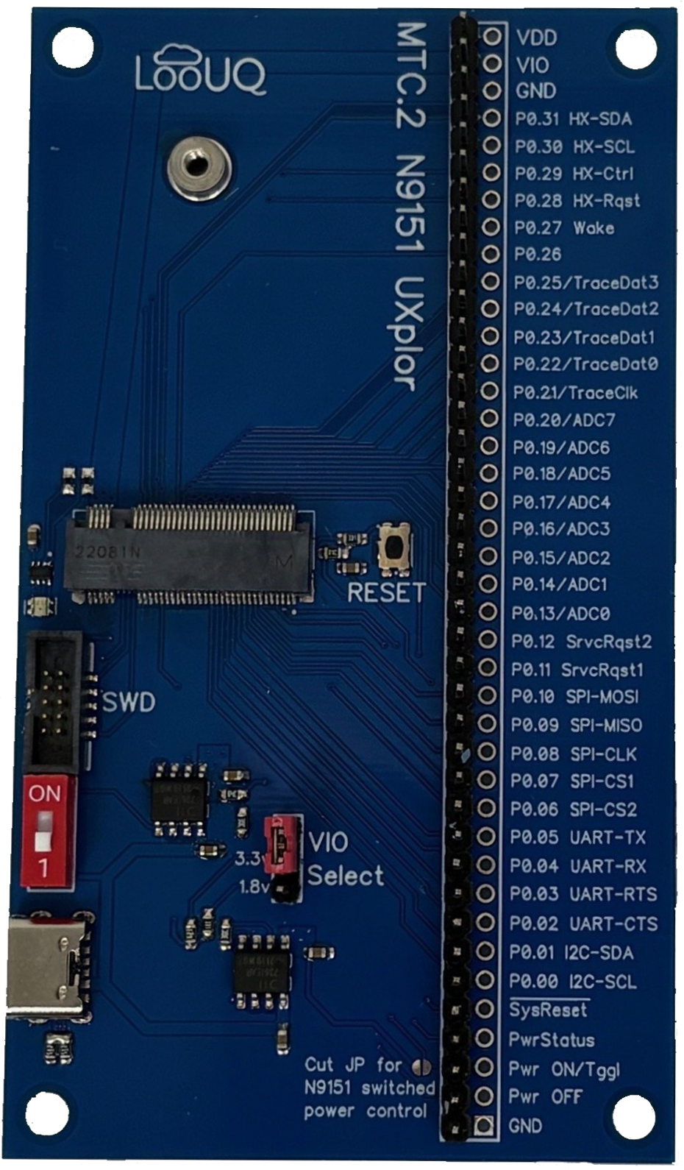
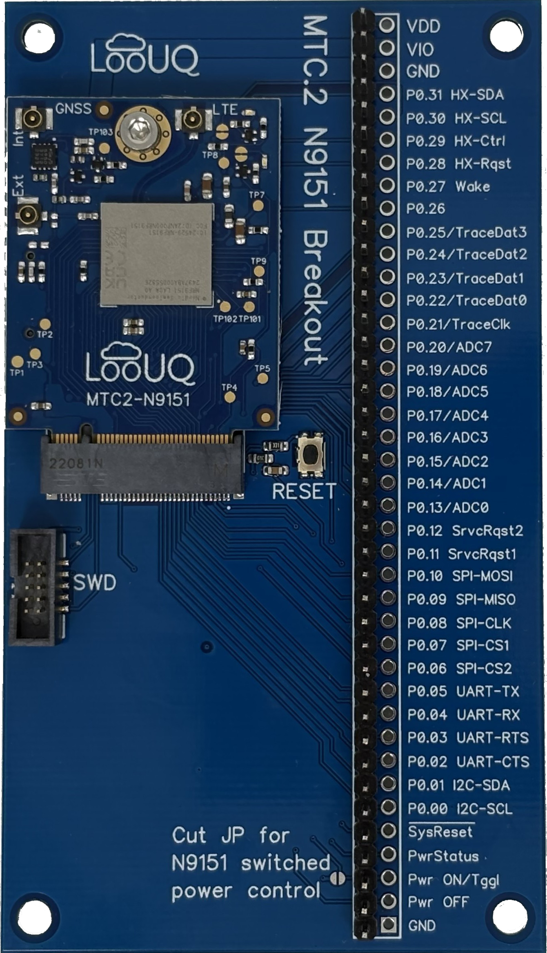
Implementing With The MTC2-N9151
Start with the MTC2-N9151 paired with one of LooUQ’s development boards: the MTC2-N9151-UXP and MTC2-N9151-BRK.
  The UXplor (UXP) is great to start software development and general project design.
  The Breakout (BRK) targets power management and battery life planning (shown with MTC2-N9151 modem).
Then… adapt your own board for the MTC2-N9151 using LooUQ provided design resources.
  MTC.2 Interface Specification
  MTC.2 Physical PCB Layout Model
  Start your design using the LooUQ reference files in DipTrace or Eagle formats to kickstart your effort.
Notes:
MTC2-N9151-UXP (UXplor board)
M.2 slot for the MTC2-N9151 modem
Header (x2) providing full-access to all nRF9151 GPIO pins
SWD header for debug port access, allows for hardware debugging of the application core (ARM Cortex-M33)
Buffered reset circuit to allow user to reset the nRF9151 SIP
Integrated USB power system to power the N9151 modem (3.7 volts, 3.3/1.8 volt jumper selectable) Note: USB is not for communications.
RGB LED indicator (via I2C and the TI LP5817 chip), LooUQ provides a driver and utility application open-source
MTC2-N9151-BRK (Breakout board)
M.2 slot for the MTC2-N9151 modem
Header (x2) providing full-access to all nRF9151 GPIO pins
SWD header for debug port access, allows for hardware debugging of the application core (ARM Cortex-M33)
Buffered reset circuit to allow user to reset the nRF9151 SIP
Both board designs are available open-source on LooUQ’s Github site to help kickstart N9151 user projects

Slide 5
By Your Side…
Please ask if questions, LooUQ is always happy to help.
Unsure? LooUQ can provide direct assistance with steps along your journey if needed.
Firmware development
Custom PC board design and manufacture
Thank You!
Notes:
LooUQ employs a ticketing system to ensure prompt replies and answers to customer questions.
Custom services available
Project consulting
Product design
Printed circuit design
Printed circuit manufacturing (via LooUQ partners)
Firmware development

